Slide 1








Power
Saturday
5 juin 2021, 11H30
Online
Creating Azure SQL Database Users Programmatically with a Service Principal using Azure DevOps
Rob Sewell
Une conférence des communautés Club Power BI, GUSS, aMS

Slide 2

Rob Sewell
Bearded Consultant
Automator
Trainer
Dual MVP
He/Him
Consultant Sewells Consulting Ltd
dbatoolsMoL dbachecks
ADSNotebooks PowerShell Community
Data Community
beard.media\book
@sqldbawithbeard
blog.robsewell.com

Slide 3

What Is The Problem ?
Photo by Andrey Metelev on Unsplash

Slide 4
What Is The Problem ?
Automate a solution to make it easy for the Operational Team to control permissions to the Azure SQL Database and Azure SQL Managed Instance estate
Photo by Andrey Metelev on Unsplash

Slide 5
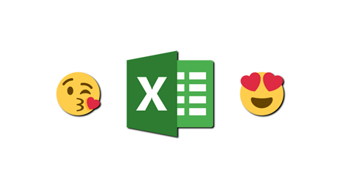
Also
“We’d Really like to use Excel”

Slide 6
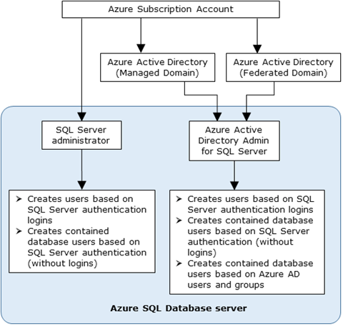
Creating Azure SQL Database Users
Admin Accounts can create
https://docs.microsoft.com/en-us/azure/azure-sql/database/authentication-aad-overview

Slide 7


Creating Azure SQL Database Users
https://docs.microsoft.com/en-us/azure/azure-sql/database/authentication-aad-overview

Slide 8

Only One Option
Photo by Olli Kilpi on Unsplash

Slide 9

Creating an AAD Contained Database User
We have an automated Infrastructure as Code deployment
We want an automated Permissions as Code pipeline
We don’t want manual intervention
Photo by Thirteen .J on Unsplash

Slide 10
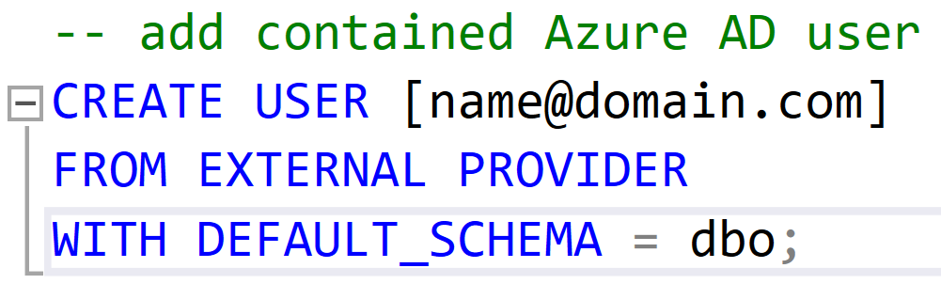
Creating an AAD Contained Database User
Only connections established with Active Directory accounts can create other Active Directory users

Slide 11

Requirements
Apply Permissions using SPN
Azure SQL Server Identity
Active Directory Admin
Directory Readers Role
Azure DevOps Pipeline
Permissions in Excel Sheet
Photo by Kelly Sikkema on Unsplash

Slide 12
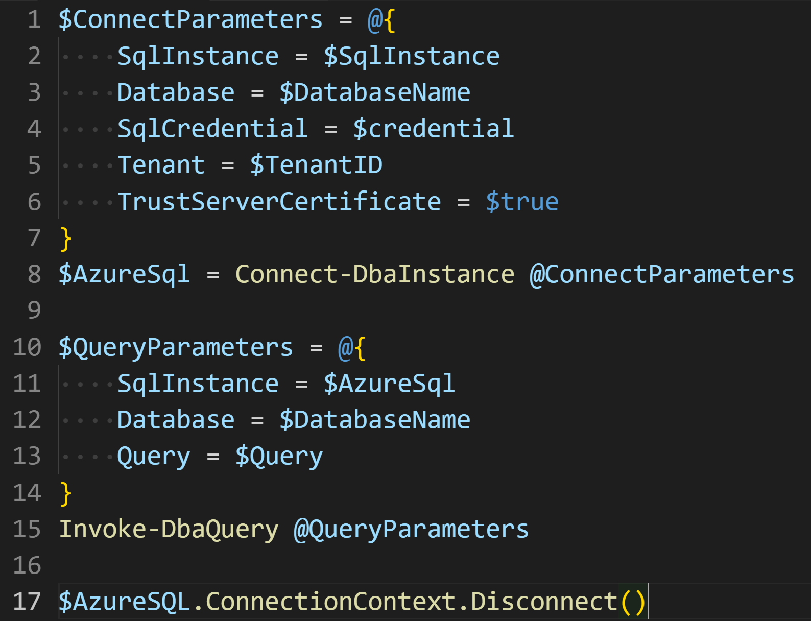
Use dbatools https://dbatools.io
Need to login as the SPN to run the T-SQL

Slide 13
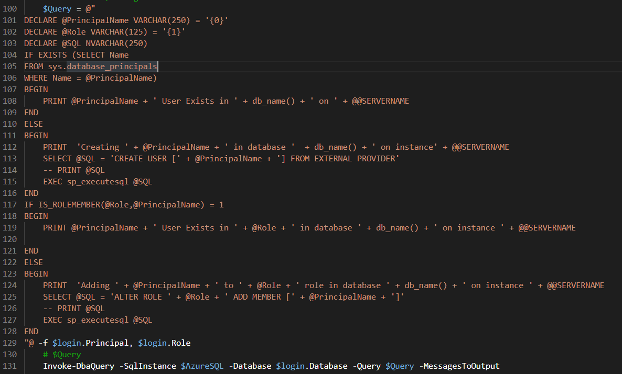

Slide 14

Requirements
Apply Permissions using SPN
Azure SQL Server Identity
Active Directory Admin
Directory Readers Role
Azure DevOps Pipeline
Permissions in Excel Sheet
Photo by Kelly Sikkema on Unsplash

Slide 15
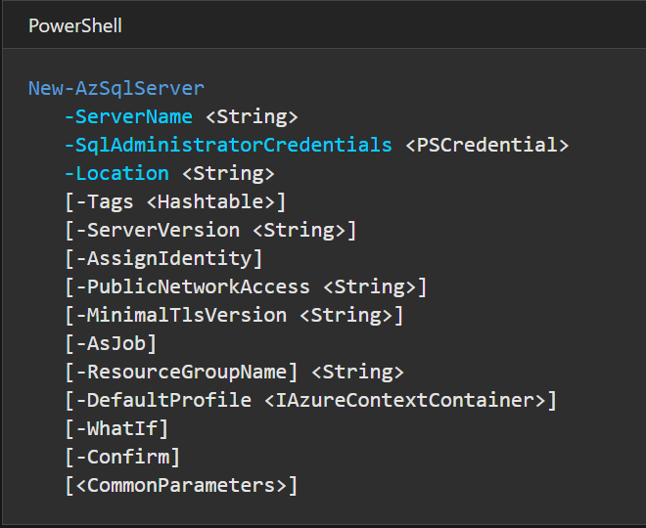
Need the SQL Server to have an Identity
https://docs.microsoft.com/en-us/powershell/module/az.sql/new-azsqlserver?view=azps-5.4.0

Slide 16
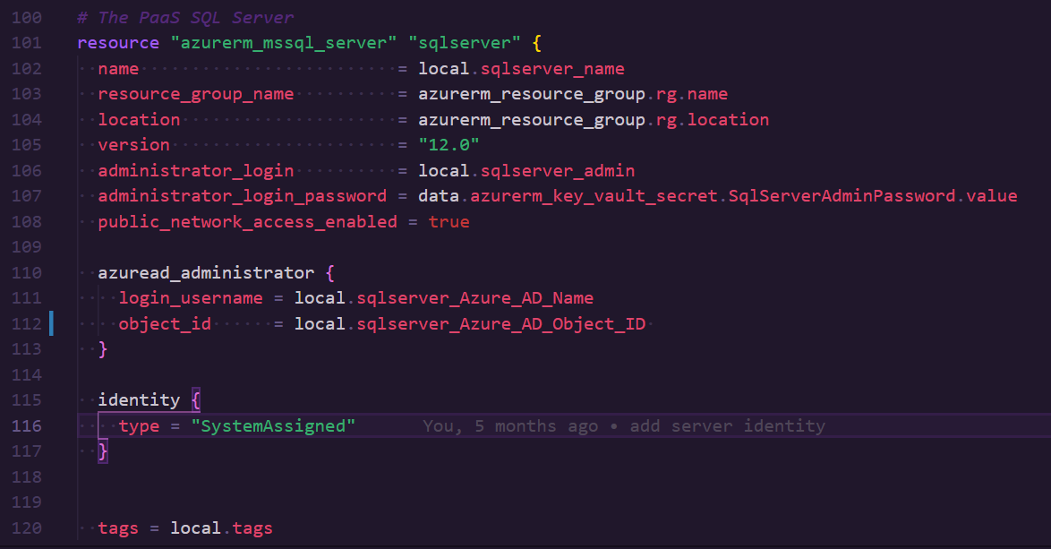
Need the SQL Server to have an Identity
https://registry.terraform.io/providers/hashicorp/azurerm/latest/docs/resources/sql_server

Slide 17
Requirements
Apply Permissions using SPN
Azure SQL Server Identity
Active Directory Admin
Directory Readers Role
Azure DevOps Pipeline
Permissions in Excel Sheet
Photo by Kelly Sikkema on Unsplash

Slide 18
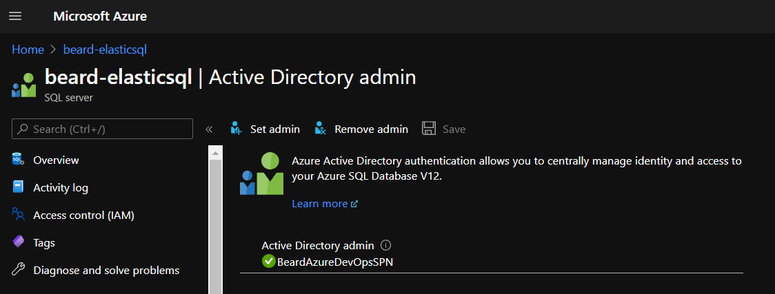
Set the Active Directory Admin

Slide 19
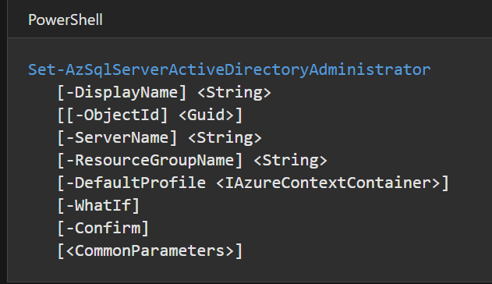
Set the Active Directory Admin
https://docs.microsoft.com/en-us/powershell/module/az.sql/set-azsqlserveractivedirectoryadministrator?view=azps-5.4.0

Slide 20
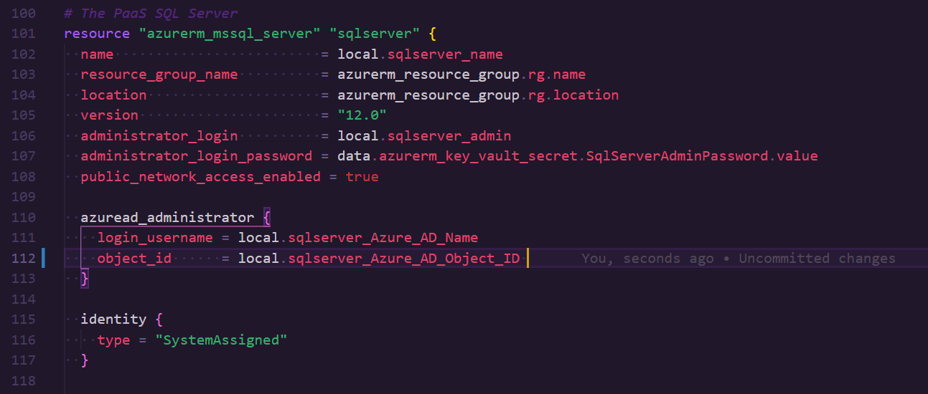
Set the Active Directory Admin
https://registry.terraform.io/providers/hashicorp/azurerm/latest/docs/resources/sql_server

Slide 21
Requirements
Apply Permissions using SPN
Azure SQL Server Identity
Active Directory Admin
Directory Readers Role
Azure DevOps Pipeline
Permissions in Excel Sheet
Photo by Kelly Sikkema on Unsplash

Slide 22
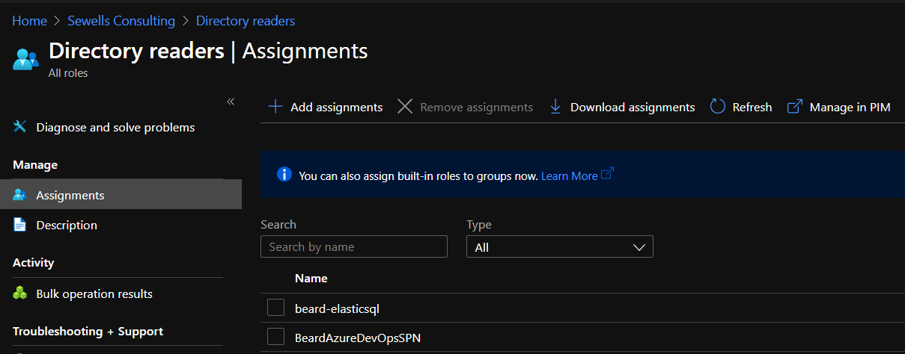
Directory Reader in AAD

Slide 23
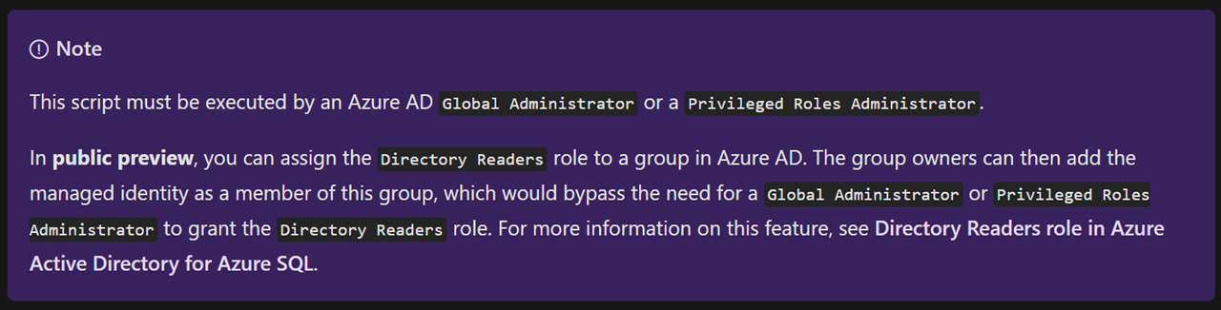
Directory Reader in AAD
https://docs.microsoft.com/en-us/azure/azure-sql/database/authentication-aad-service-principal-tutorial

Slide 24
Requirements
Apply Permissions using SPN
Azure SQL Server Identity
Active Directory Admin
Directory Readers Role
Azure DevOps Pipeline
Permissions in Excel Sheet
Photo by Kelly Sikkema on Unsplash

Slide 25
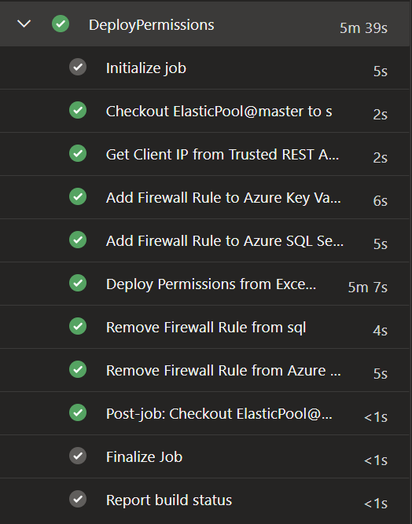
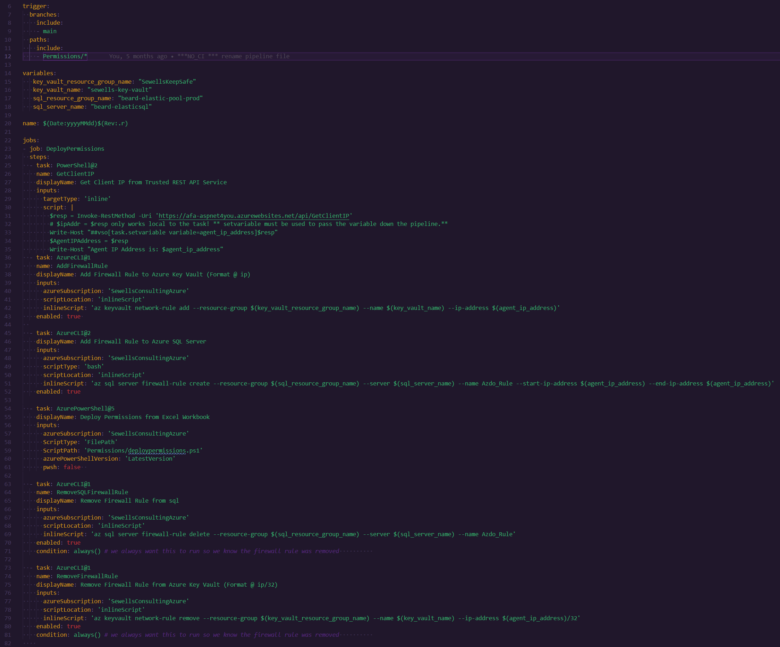
pipeline

Slide 26
pipeline

Slide 27
pipeline

Slide 28
pipeline

Slide 29
pipeline

Slide 30
Requirements
Apply Permissions using SPN
Azure SQL Server Identity
Active Directory Admin
Directory Readers Role
Azure DevOps Pipeline
Permissions in Excel Sheet
Photo by Kelly Sikkema on Unsplash

Slide 31
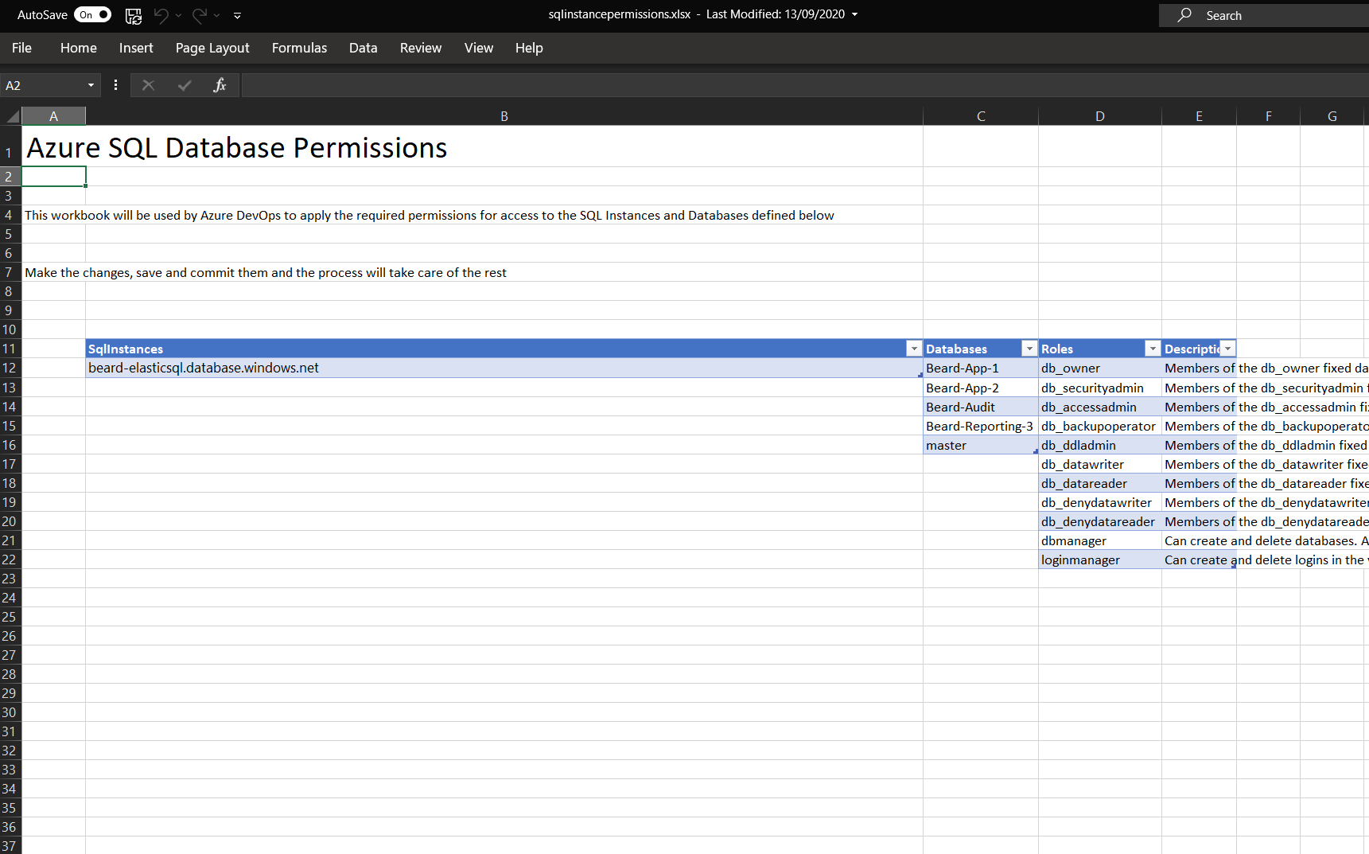
pipeline

Slide 32
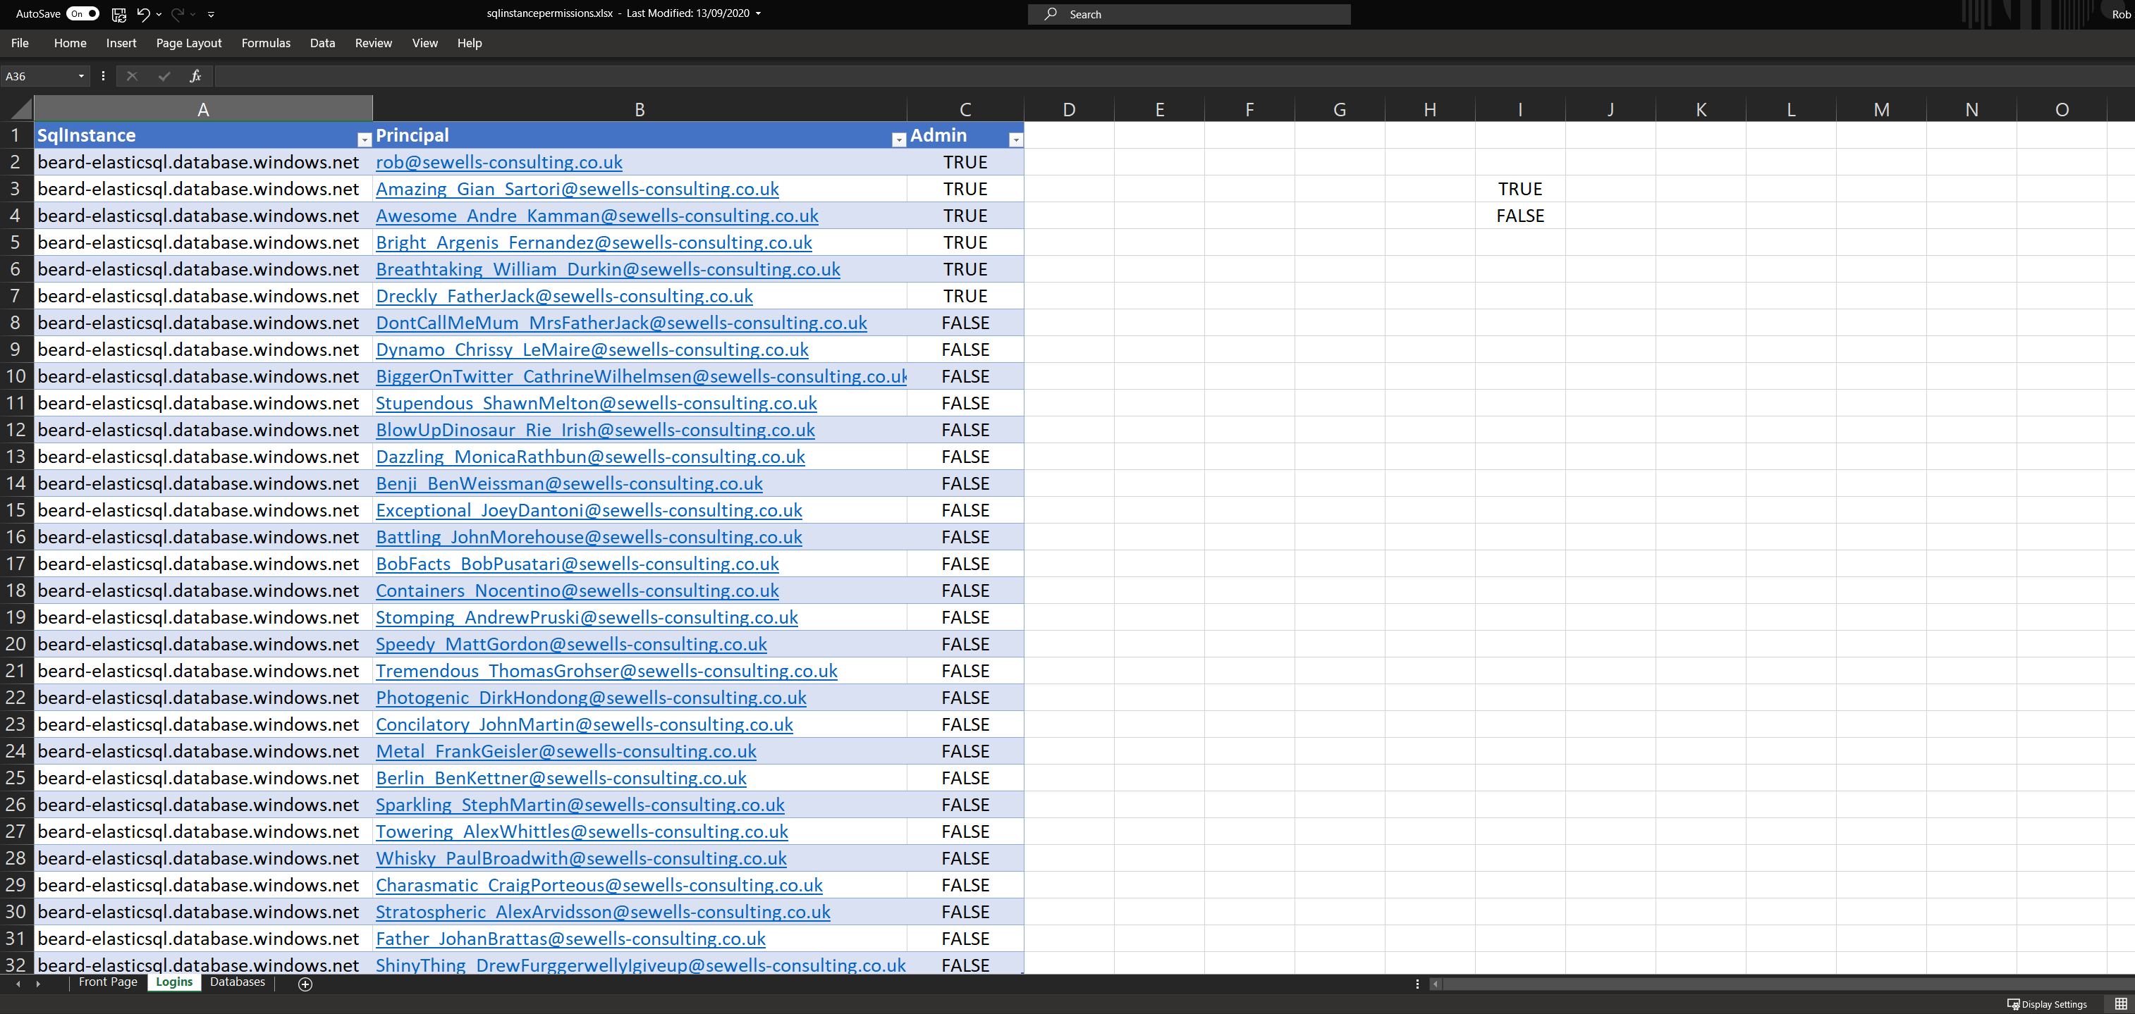
pipeline

Slide 33
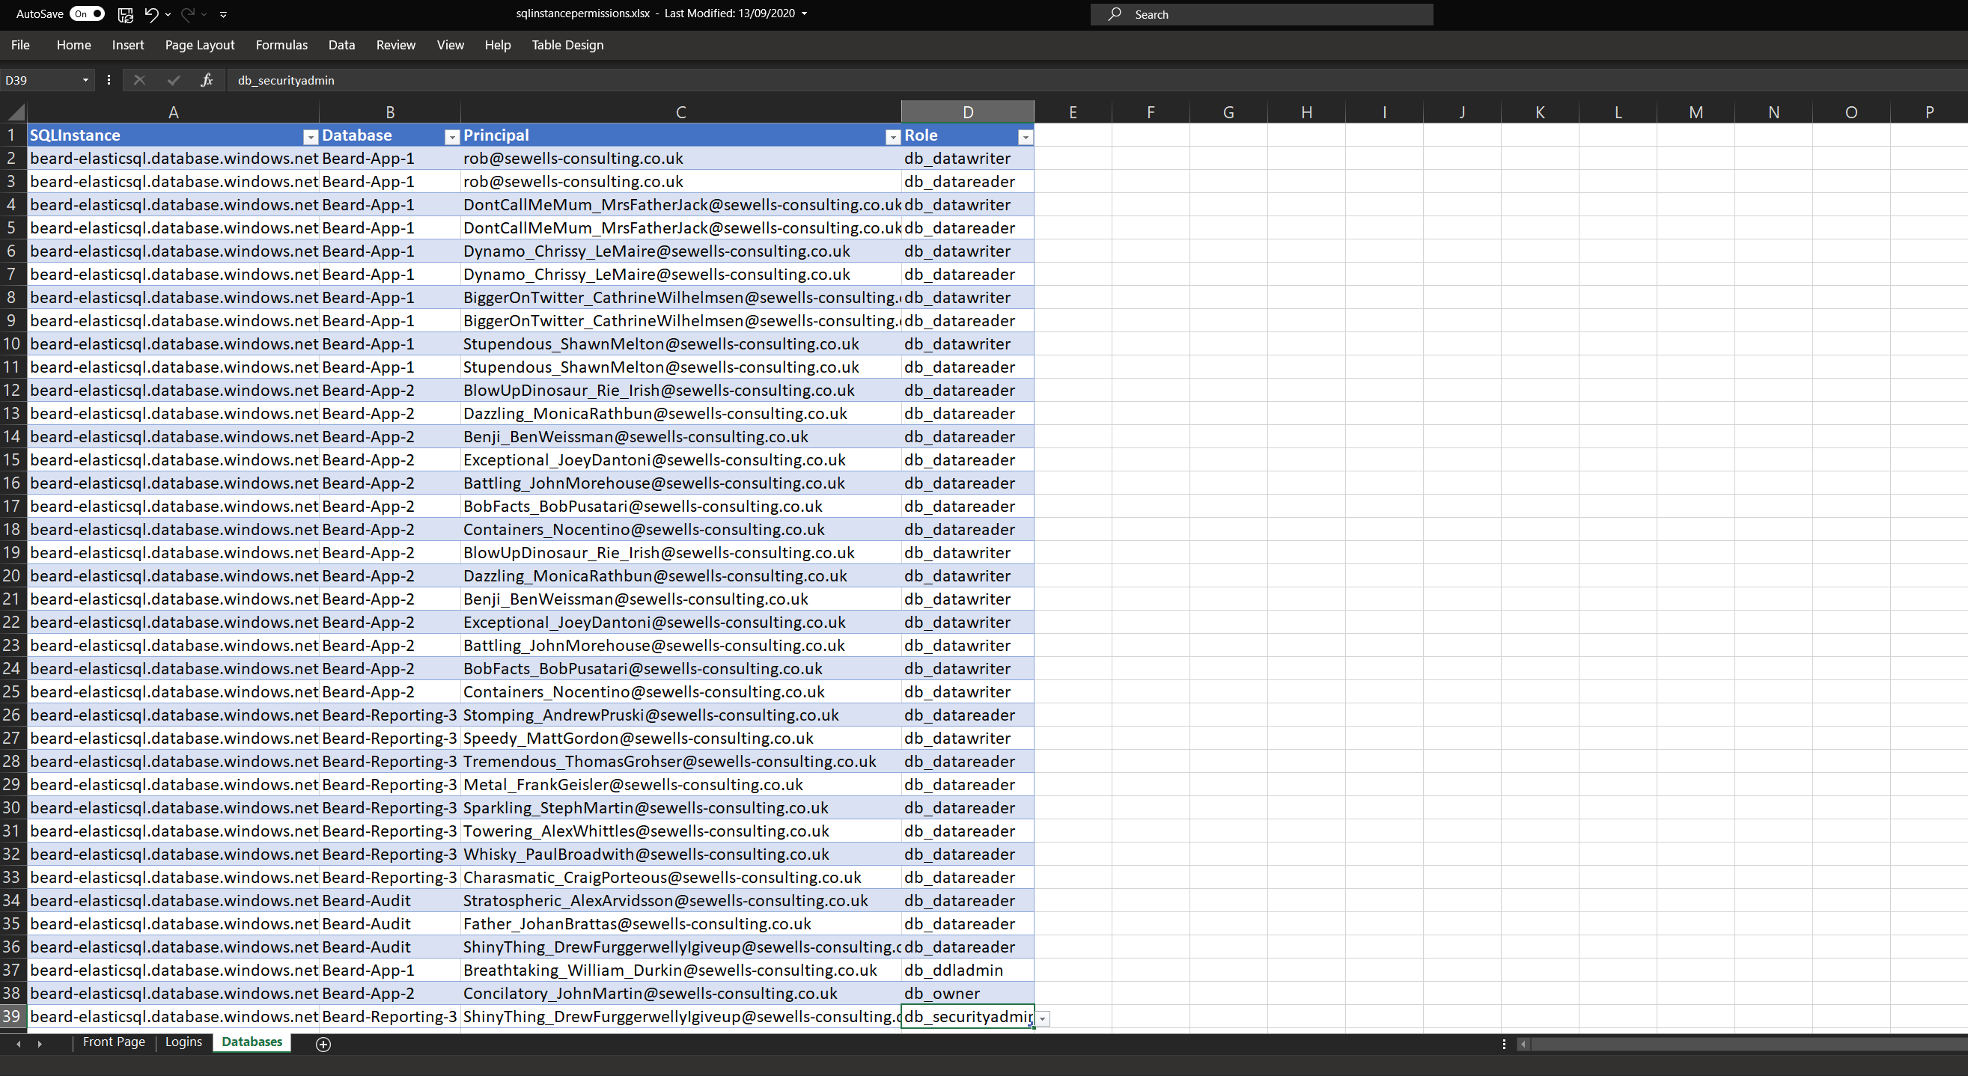
pipeline

Slide 34
Requirements
Apply Permissions using SPN
Azure SQL Server Identity
Active Directory Admin
Directory Readers Role
Azure DevOps Pipeline
Permissions in Excel Sheet
Photo by Kelly Sikkema on Unsplash

Slide 35
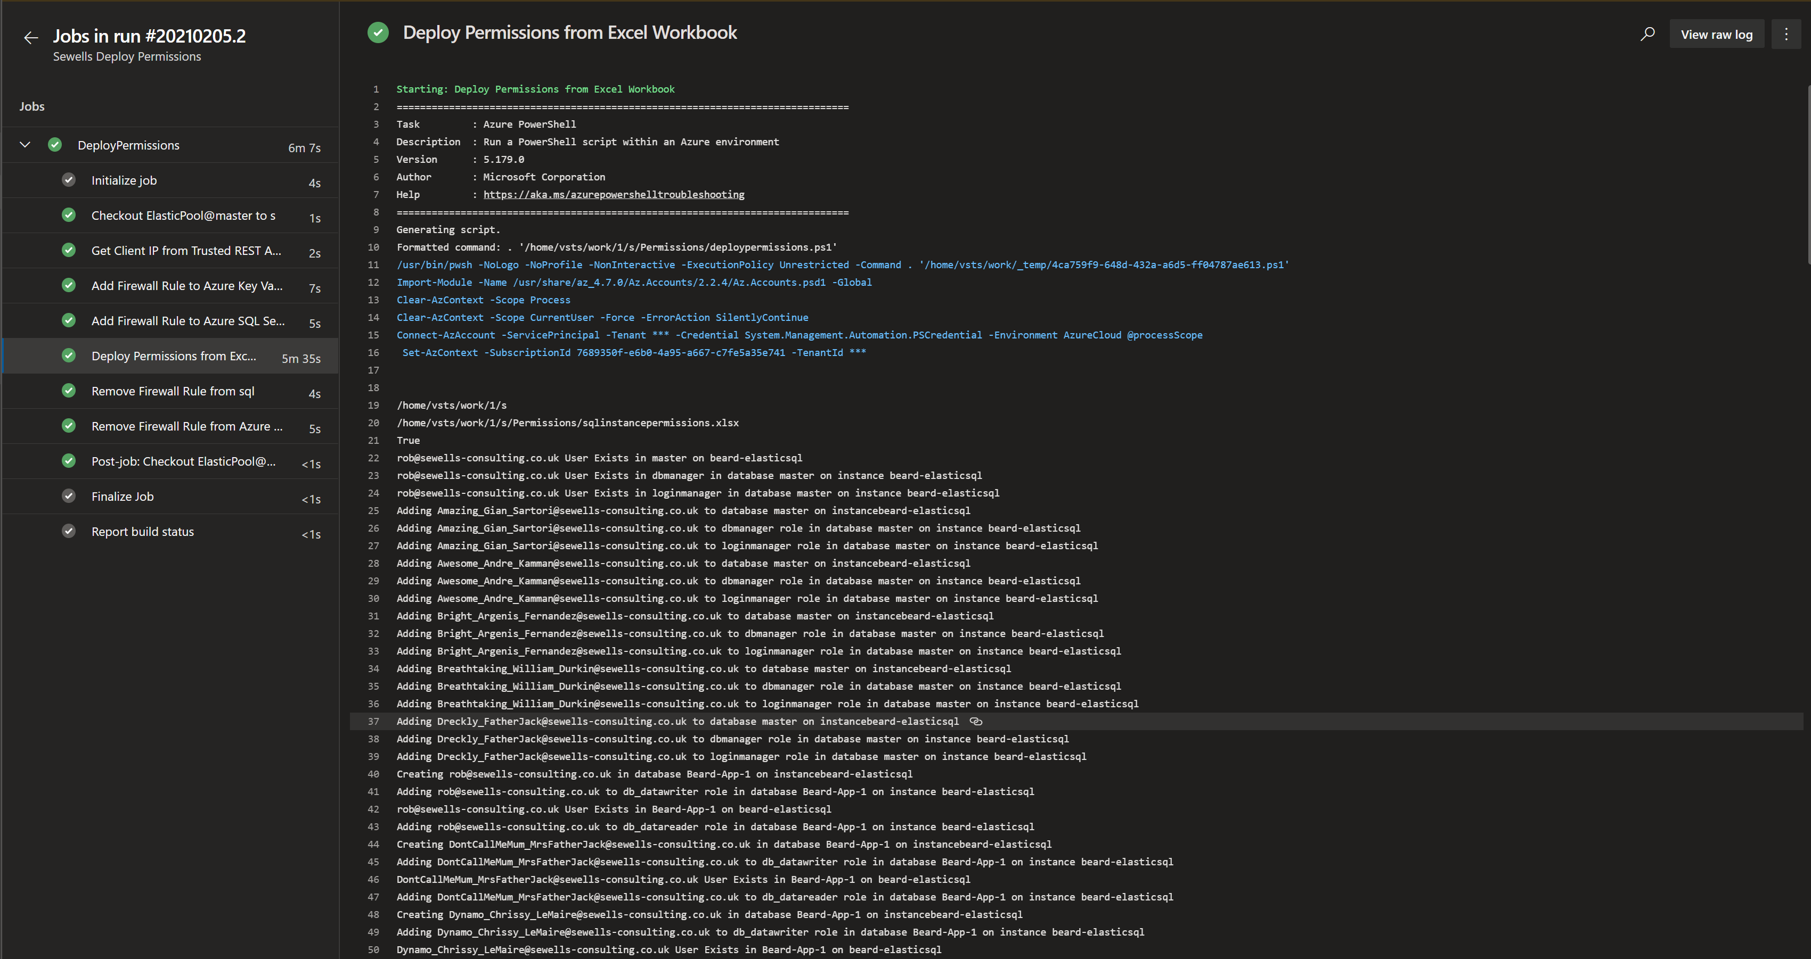
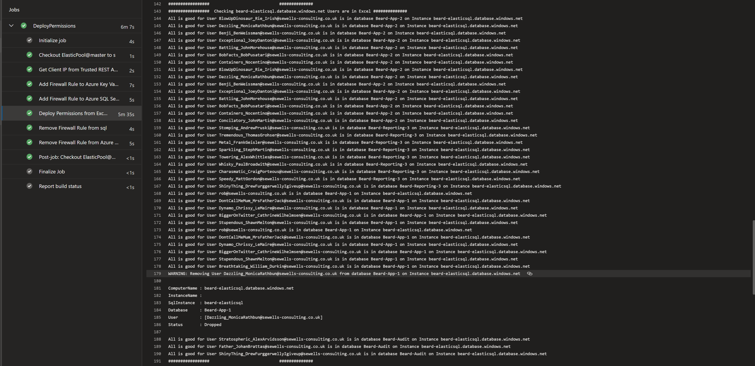
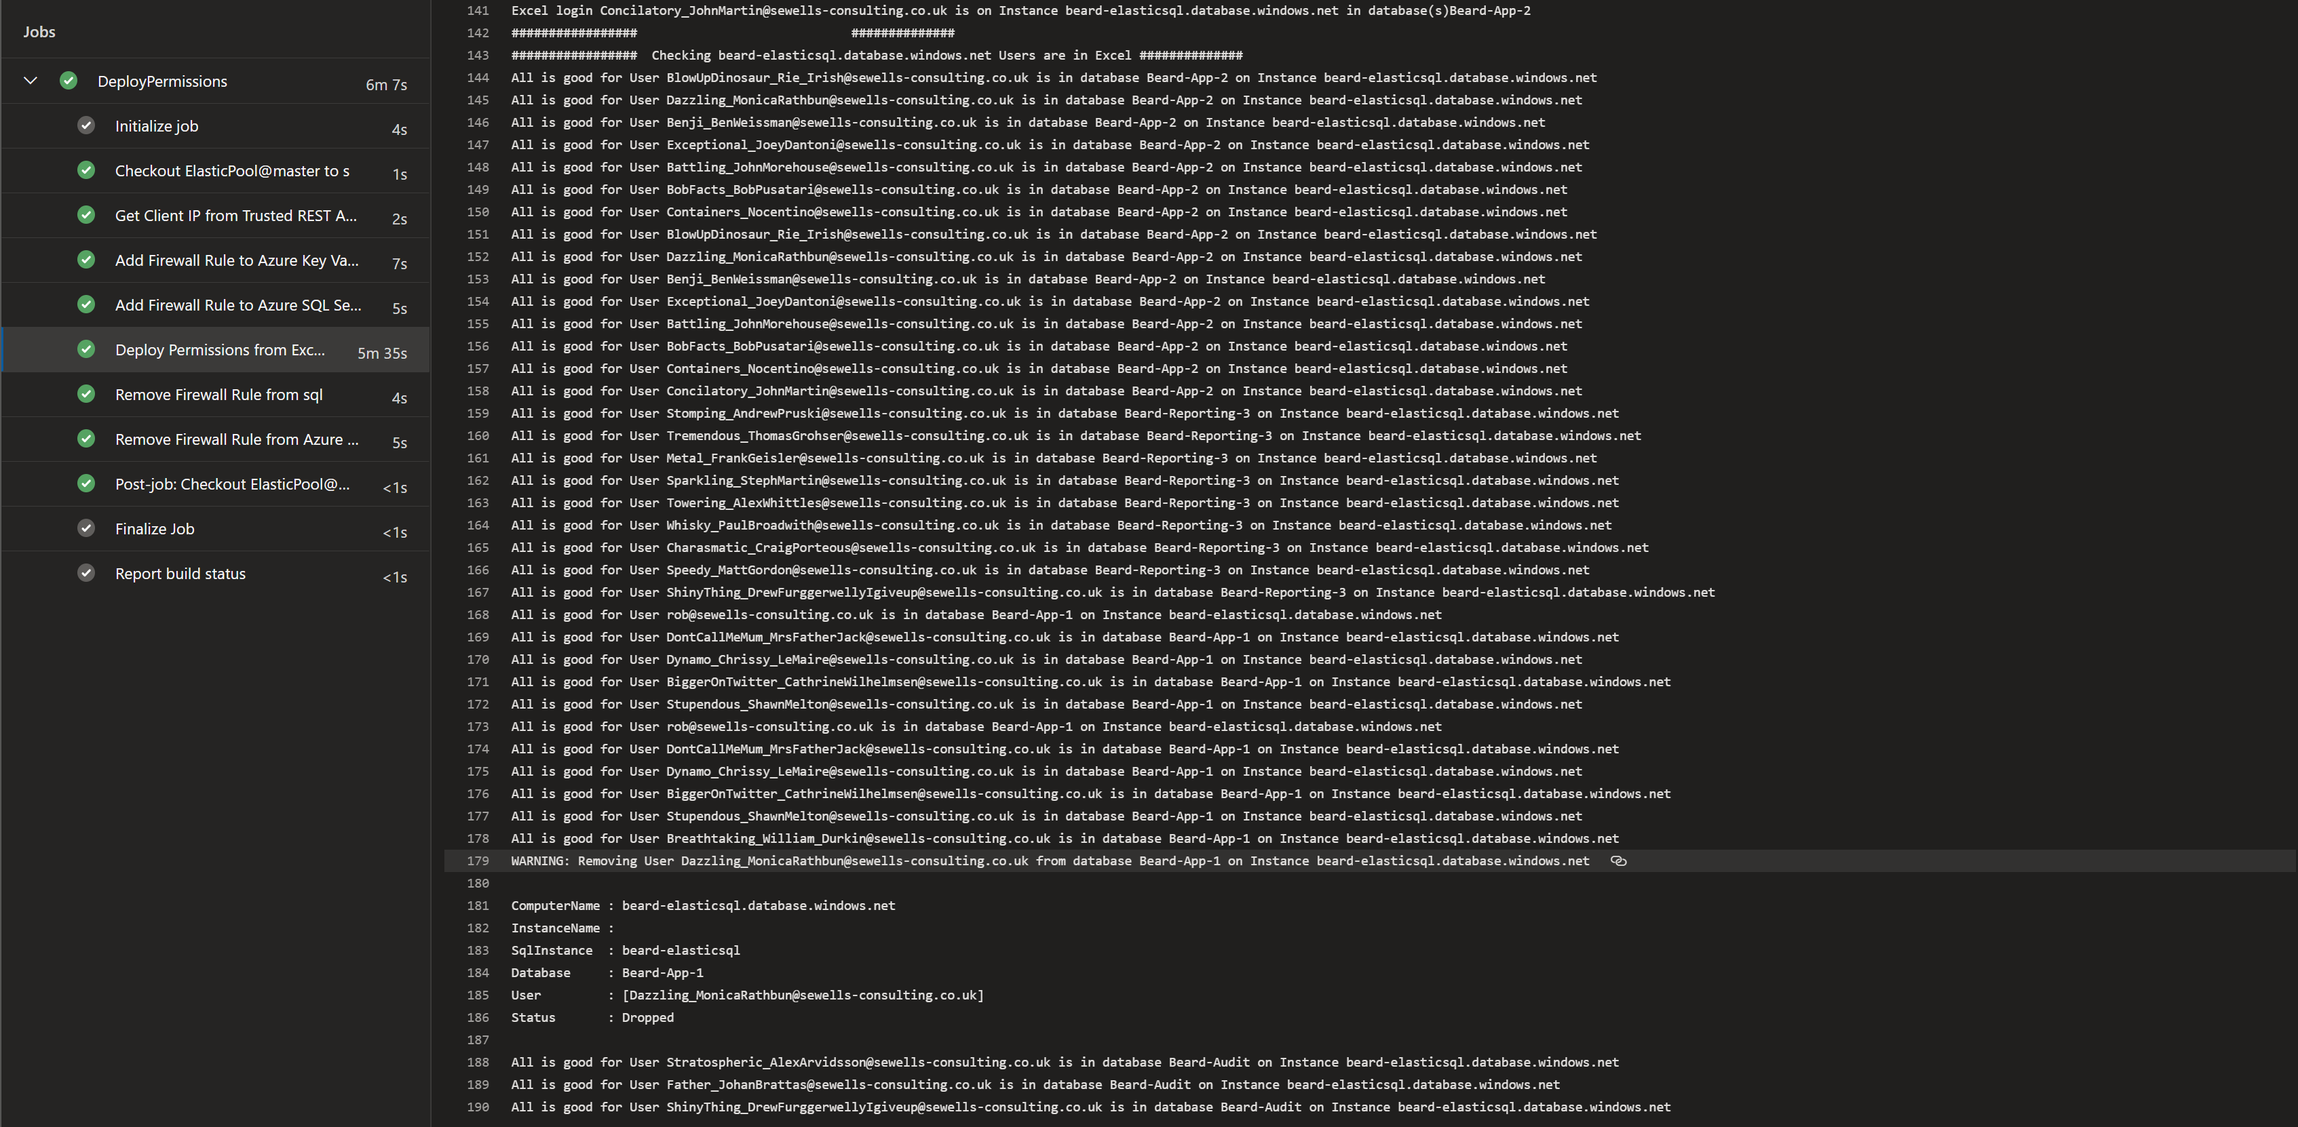
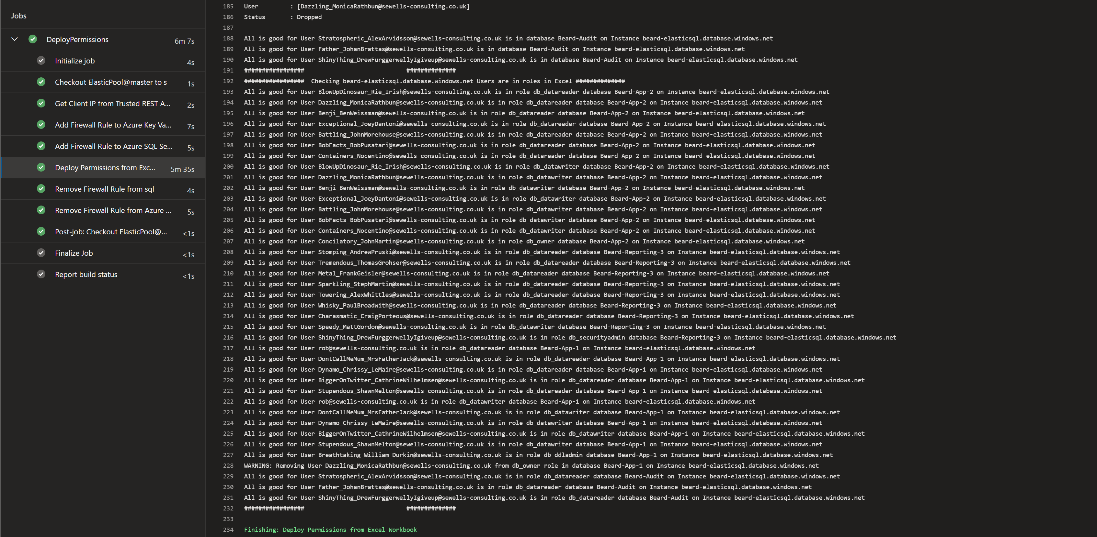
pipeline

Slide 36
pipeline

Slide 37
pipeline

Slide 38
pipeline

Slide 39
So now we have all that we need
Excel File for Permissions
Azure SQL instance with AAD Identity
SPN with Directory Reader
dbatools to run the query
Azure Key Vault for storing secrets
Azure DevOps for running the code

Slide 40

Merci!
Rob Sewell
beard.media\book
@sqldbawithbeard
blog.robsewell.com
Prenez 2 minutes pour évaluer cette session (RDV dans l’espace de conversation)

